Slide 1
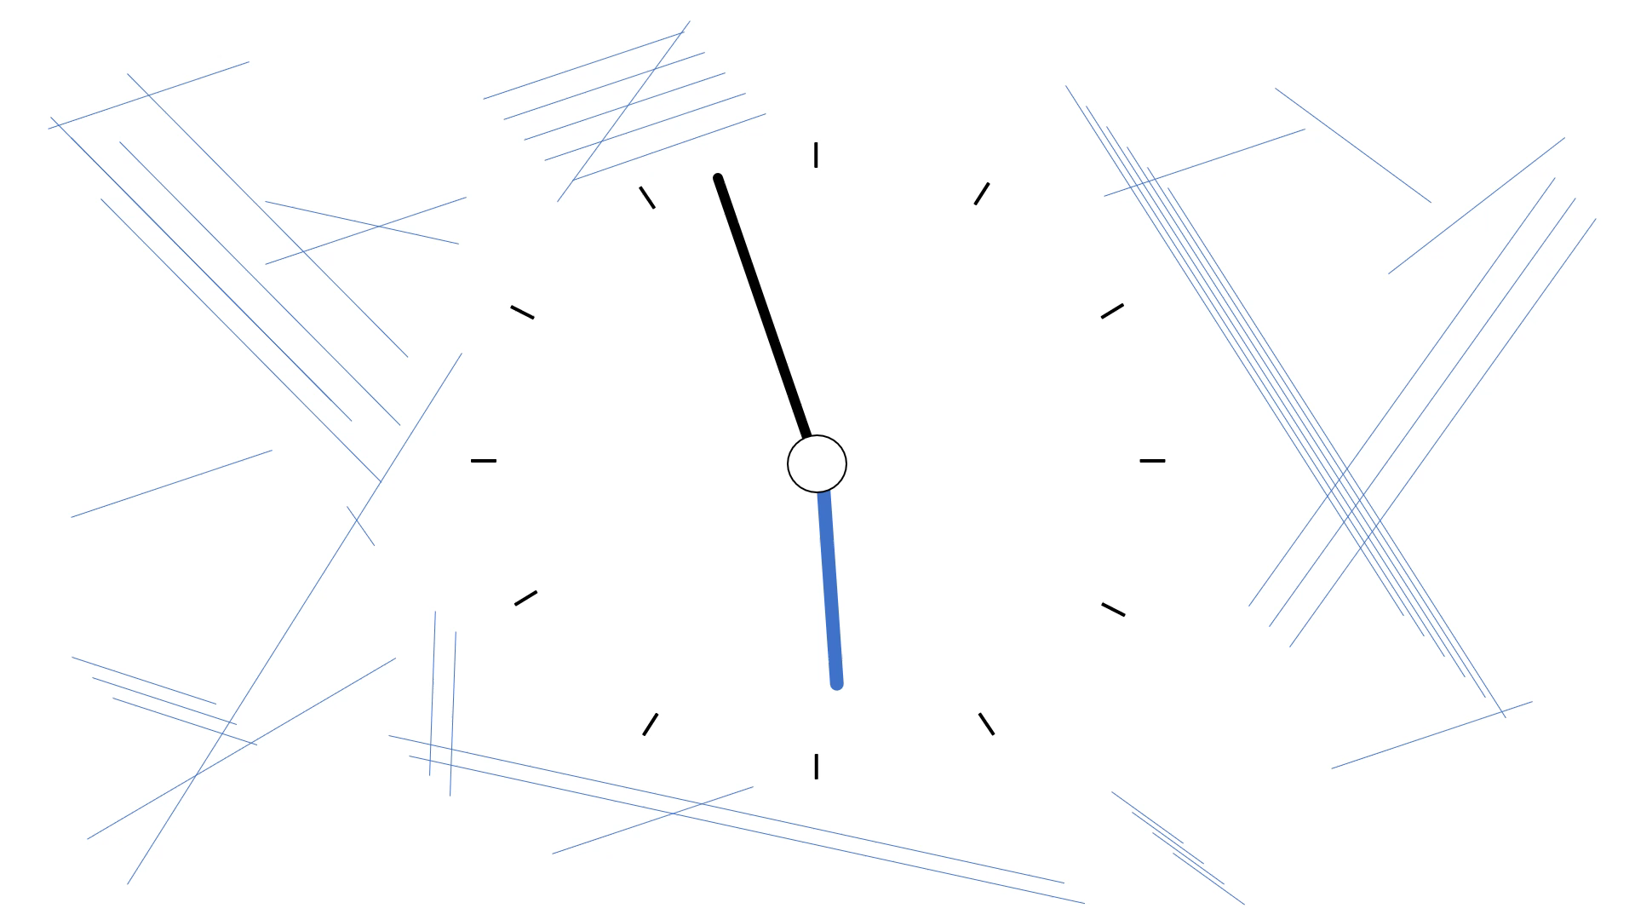

Slide 2

WELCOME
Home of Distinctions
Subject: Mathematics
Topic: Analytical Geometry
Grade 11
Vid 1 of 1
With ET BOSHIELO
(UJ, BSc in Computer Science & informatics)

Slide 3

Outline
do
{
practice_math( );
} while( Learner.equals(DoeVid));
Lines:
The Distance
The Midpoint
Gradient
Inclination of a line
Equation of a line
Perpendicular and Parallel lines
Median of a triangle
Altitude
Perpendicular bisector
Collinear Points and Intersecting lines
X and Y Intercepts
RS Questions

Slide 4
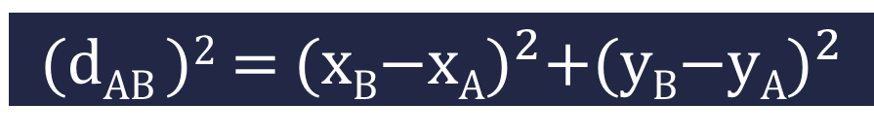
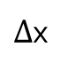
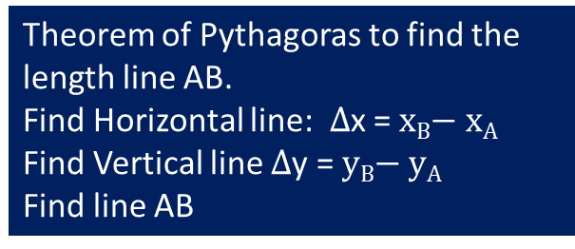
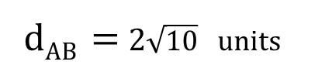
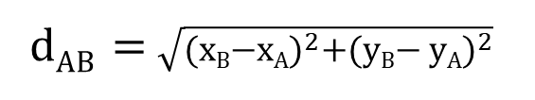
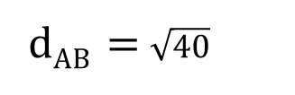
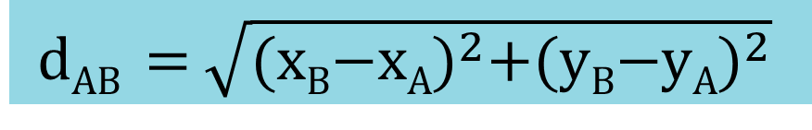
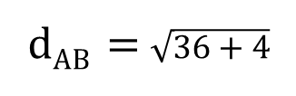
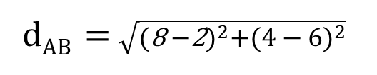

The Distance Between Two points
d_{AB} = $\sqrt{{(\text{x}\text{B}\text{−}\text{x}\text{A})}^{2}+{(\text{y}\text{B}\text{−}\text{y}\text{A})}^{2}}$
A (2 ; 6)
d_{AB} = $\sqrt{{(\text{x}\text{B}\text{−}\text{x}\text{A})}^{2}+{(\text{y}\text{B}\text{− }\text{y}\text{A})}^{2}}$
Square both sides
$∆$y
d_{AB} = $\sqrt{{(\text{8} \text{−}\text{2})}^{2}+{(\text{4 }\text{− }\text{6})}^{2}}$
Theorem of Pythagoras to find the length line AB.
Find Horizontal line: $∆$x = $\text{x}\text{B}\text{− }\text{x}\text{A}$
Find Vertical line $∆$y = $\text{y}\text{B}\text{− }\text{y}\text{A}$
Find line AB
Introduce Square Root on both sides
B(8 ; 4)
d_{AB} = $\sqrt{36+4}$
$∆$x
d_{AB} = $\sqrt{40}$
d_{AB} = 2$\sqrt{10}$ units
(d_{AB} )² = ${(\text{x}\text{B}\text{−}\text{xA})}^{2}+{(\text{y}\text{B}\text{−}\text{yA})}^{2}$
r² = x² + y²

Slide 5
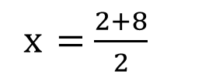
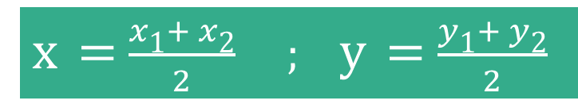
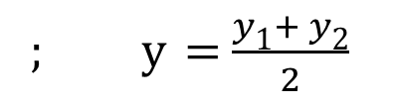
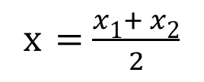



The Midpoint of a Line
x = $\frac{x\text{1}+ x\text{2}}{2}$ ; y = $\frac{y\text{1}+ y\text{2}}{2}$
A (2 ; 6)
x = $\frac{x\text{1}+ x\text{2}}{2}$
; y = $\frac{y\text{1}+ y\text{2}}{2}$
B(x ; y)
x = $\frac{2+8}{2}$
; y = $\frac{6+2}{2}$
C(8 ; 2)
x = $5$
; y = $4$
Note:
You can be given Coordinates of the midpoint and be asked to calculate a certain x or y coordinate
B(x ; y)
B(5 ; 4)

Slide 6
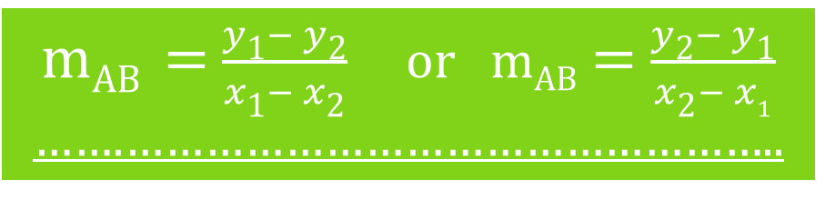
Gradient of a Line
m_{AB} = $\frac{y\text{1}− y\text{2}}{x\text{1}− x\text{2}}$ or m_{AB} = $\frac{y\text{2}− y\text{1}}{x\text{2}− x1}$
…….…………………………………………..
m > 0
m < 0

Slide 7
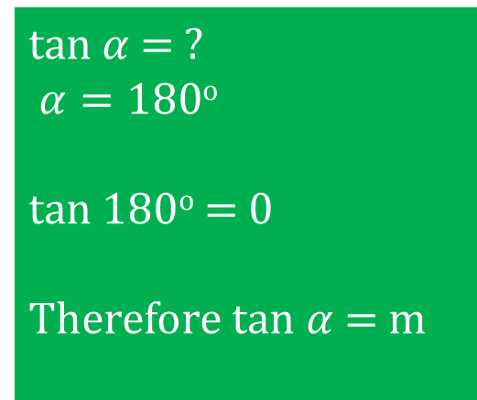

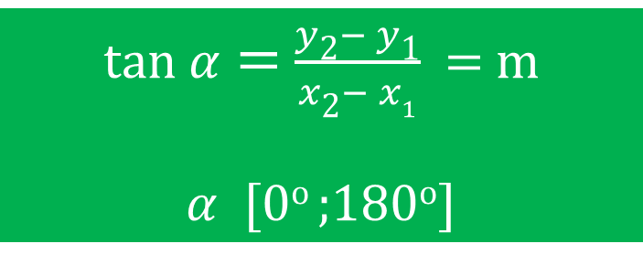


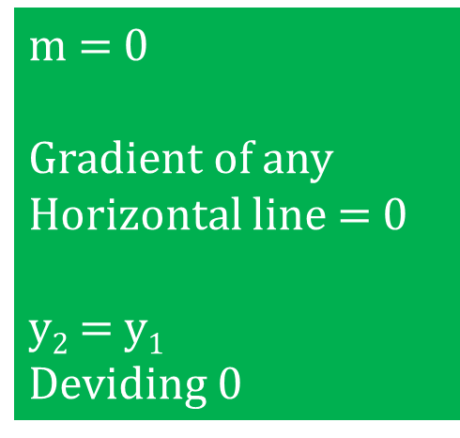
Inclination of a Line
tan $α$ = $\frac{y\text{2}− y\text{1}}{x\text{2}− x1}$ = m
$α$ [0º ;180º]
Note:
If tan $α$ > 0 , $α$is an acute angle
If tan $α$ < 0, $α$ is an obtuse angle
m = 0
Gradient of any
Horizontal line = 0
y$\text{2}$ = y$1$
Deviding 0
tan $α$ = ?
$α=180$º
tan 180º = 0
Therefore tan $α$ = m
$$α$$
Inclination angle is measured in Anticlockwise direction

Slide 8

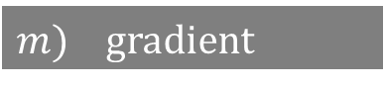


Equation of a Line
$$y=mx+c$$
$m$) gradient
$c$) y-intercept
$$y−y_{1}=m(x−x_{1})$$
You need the co-ordinates of One
point and the gradient to find the equation of a straight line.

Slide 9

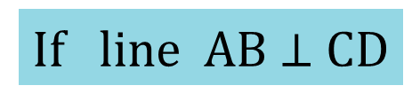
Perpendicular Lines
C
If line AB $⊥$ CD
A
B
m_{AB} x m_{CD} = -1
D
Parallel Lines
A
C
If line AB $∥$ CD
>
>
m_{AB} = m_{CD}
D
B

Slide 10


Median of a triangle
C
A line that cuts the opposite side of a triangle into two equal parts
A
$$∥$$
$$∥$$
B
D
Equation of median
Line CD is the median
Find D coordinates, midpoint of AB
Use C and D to find the equation

Slide 11

Altitude
C
A line that is perpendicular to the opposite side of a triangle
D
$$∟$$
Equation of altitude
A
B
Find the gradient of AC
Line BD is an altitude
Find the gradient of BD(altitude) using m_{BD} X m_{AC} =-1
Use the gradient of BD(altitude) and point B to find the equation

Slide 12

Altitude
C
A line that is perpendicular to the opposite side of a triangle
D
$$∟$$
Equation of altitude
A
B
Find the gradient of AC
Line BD is an altitude
Find the gradient of BD(altitude) using m_{BD} X m_{AC} =-1
Use the gradient of BD(altitude) and point B to find the equation

Slide 13



Perpendicular bisector
C
D
A line that is perpendicular to the opposite side of a triangle
$$∥$$
$$∟$$
O
$$∥$$
Equation of perpendicular bisector
A
E
B
Find O coordinates, midpoint of AC
Find the gradient of AC
Line DE perpendicular bisector of line AC
Find the gradient of DE using
m_{DE} X m_{AC} = -1
Use the gradient of DE and point O to find the equation

Slide 14

Collinear Points
A (x_{A} ; y_{A}) B (x_{B} ; y_{B}) C (x_{C} ; y_{C})
Points are collinear if they have the same gradient or lie on the same line
m_{AB} = m_{BC}
$\frac{y\text{A}− y\text{B}}{x\text{A}− x\text{B}}$ = $\frac{y\text{B}− y\text{C}}{x\text{B}− x\text{C}}$
Intersecting Lines
1. Equate the two equations
2. Solve for x simultaneously
3. Substitute x-value in to one of the original equations and find the corresponding y-value
A point where two graphs meet.

Slide 15
X Intercept
y = 0 on the x-axis
Let y = 0
Y Intercept
x = 0 on the y-axis
Let x = 0

Slide 16
Vertex: a corner of a shape where two lines intersect
Collinear: points that lie on the same straight line
Bisect: to cut in half
Inclination of a line: The angle which a line makes with the positive x-axis
You must revise the properties of different types of triangle, quadrilaterals and lines.

Slide 17
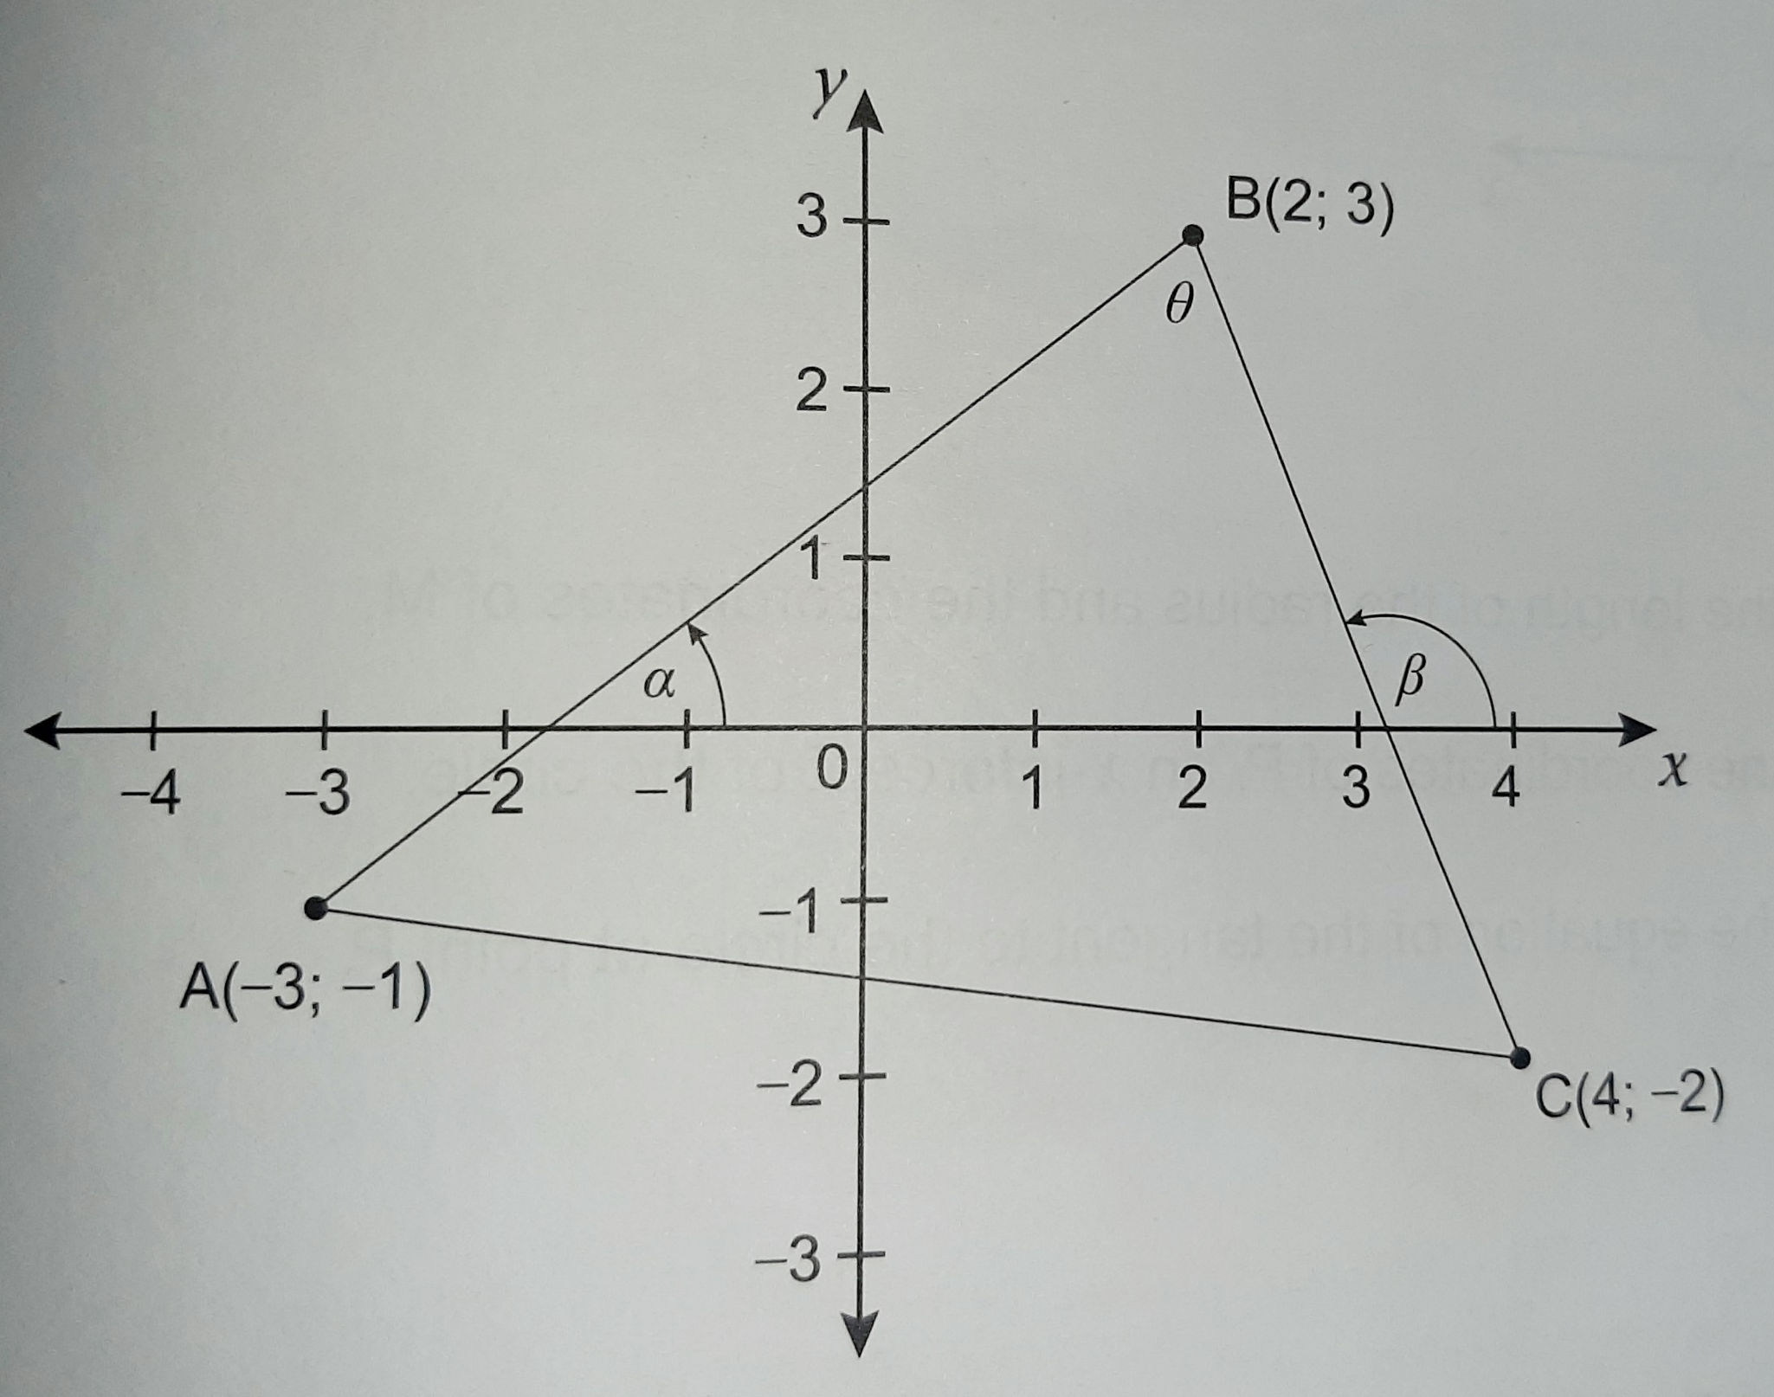

RS Questions
Note:
You are to attempt the following questions and submit them for Marking, Good Luck!
$∆$ABC is shown in the triangle below.
1. Calculate the product of the length AB and length BC {4}
2. Find the midpoint of the line AC and line AB {4}
3. Is line BC perpendicular to line AB ?, Prove {5}
4. Find angle β {1}
5. Find the equation of line AC {3}
6. Is point B collinear to point C ? , give a reason. {1}
TOTAL {18}
These questions are set to test your ability of following instructions.

Slide 18


Tutor details
Name: ET BOSHIELO Contact no: 076 432 3216 Email address: emahlwele05@gmail.com University of Johannesburg, BSc in Computer Sciences & Informatics

Slide 19
Books Used To Compile The Slides
Study and Master Mathematics(grade 11)
Siyavula Mathematics(Grade 11)
Via Afrika Mathematics Grade 11 Study Guide
Additional Material used:
Past Mathematics P2 Question Papers
Grade 11 ATP for Mathematics

Slide 20
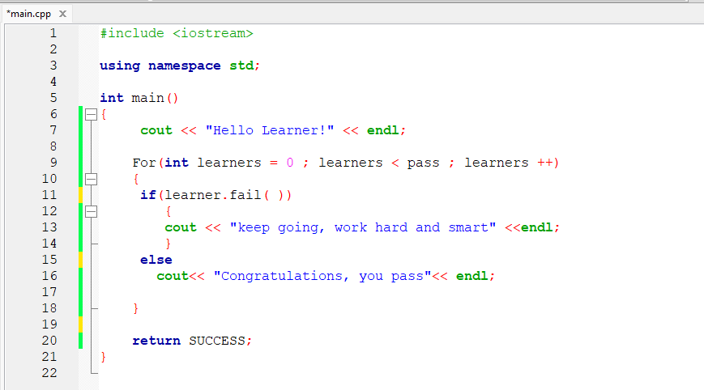

Bibliography
v

